Slide 1
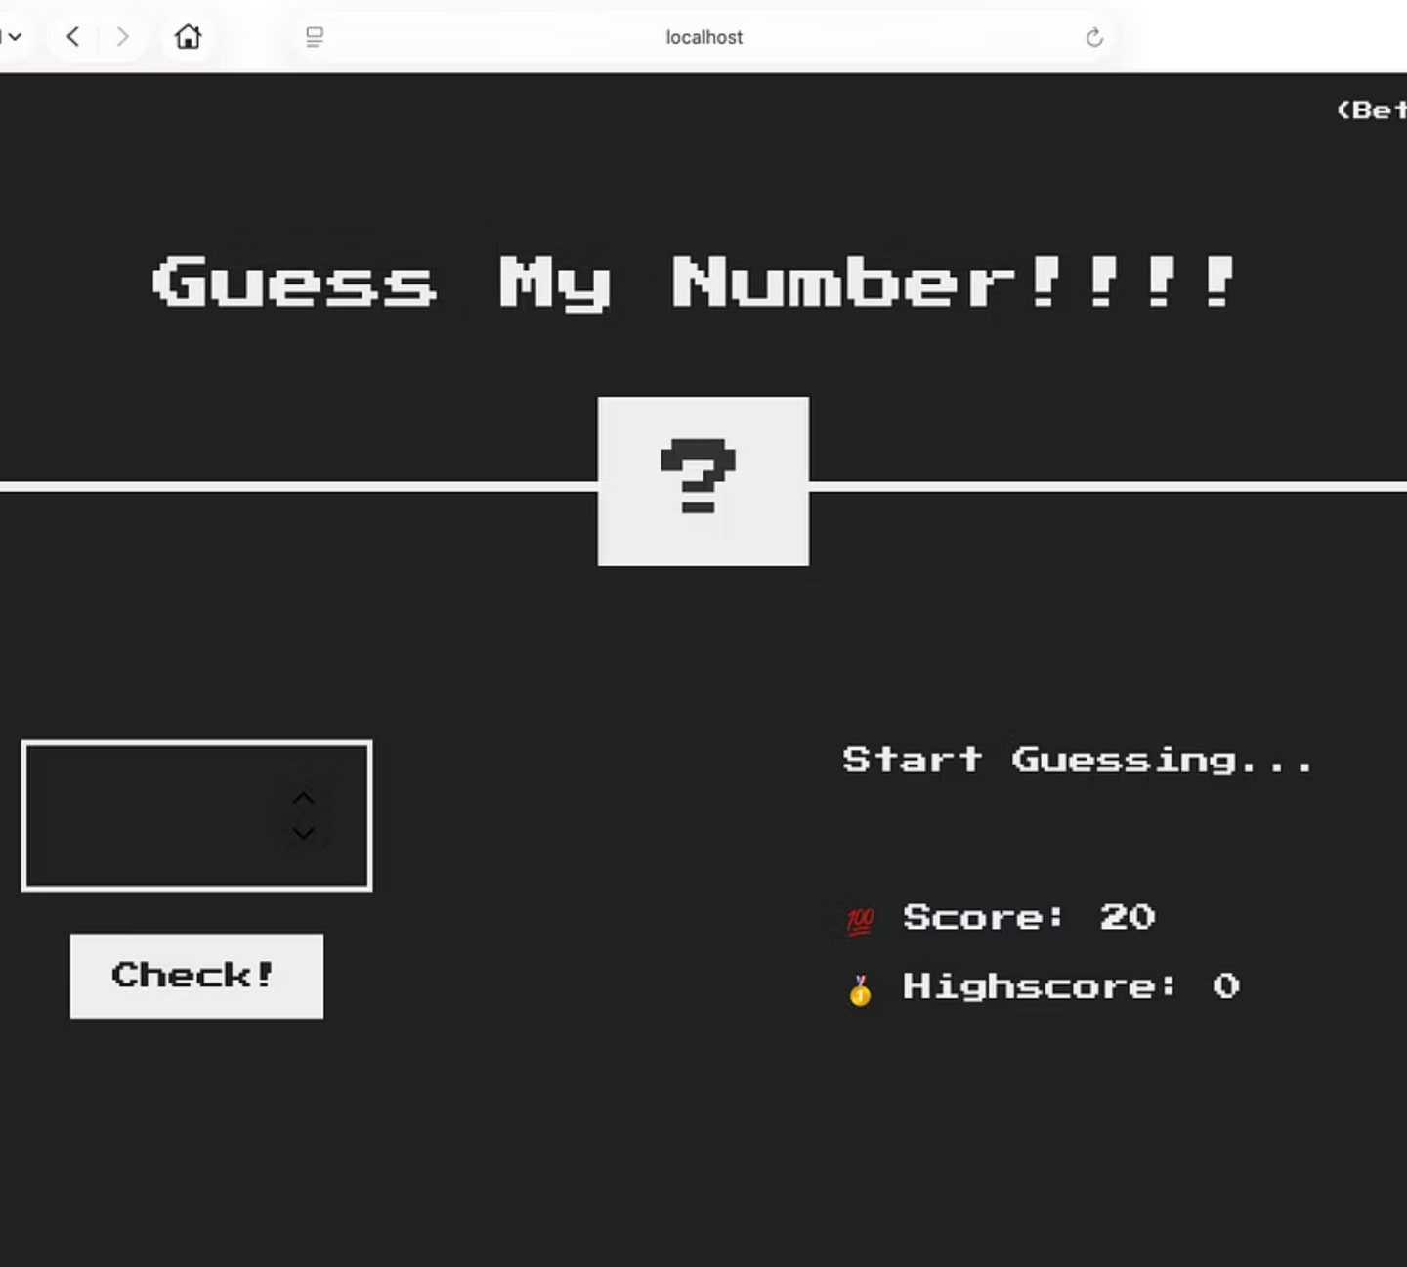
Dev Ops Pipelinening
Project summary on GitHub deployment and integrating services
Manraj Singh Gandhi
22070122114
Notes:
1

Slide 2
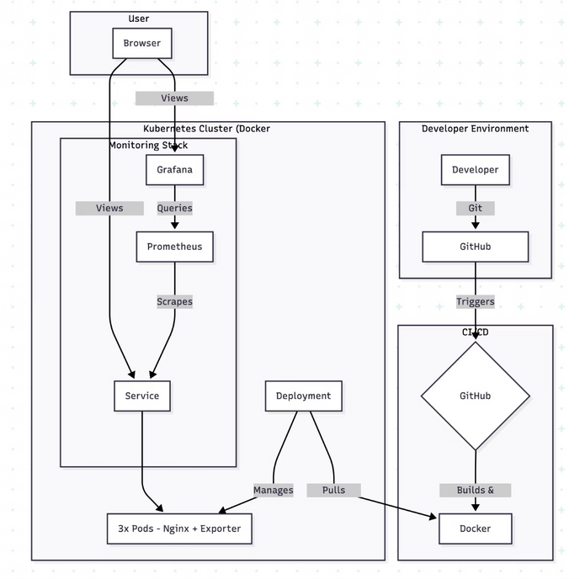
The Complete DevOps Workflow: System Architecture
A end-to-end pipeline covering the entire software lifecycle from development to production monitoring.
Source Control & CI/CD
Containerization & Artifacts
Starts with a code push to Git, triggering an automated pipeline using GitHub Actions.
Code is built into a lightweight Docker image (with Nginx) and pushed to Docker Hub for versioning.
Orchestration
Monitoring & Visualization
Kubernetes manages deployment, pulling the image and ensuring high availability with 3 replicas.
Prometheus scrapes application metrics, which are visualized in real-time using Grafana.
Notes:
2

Slide 3
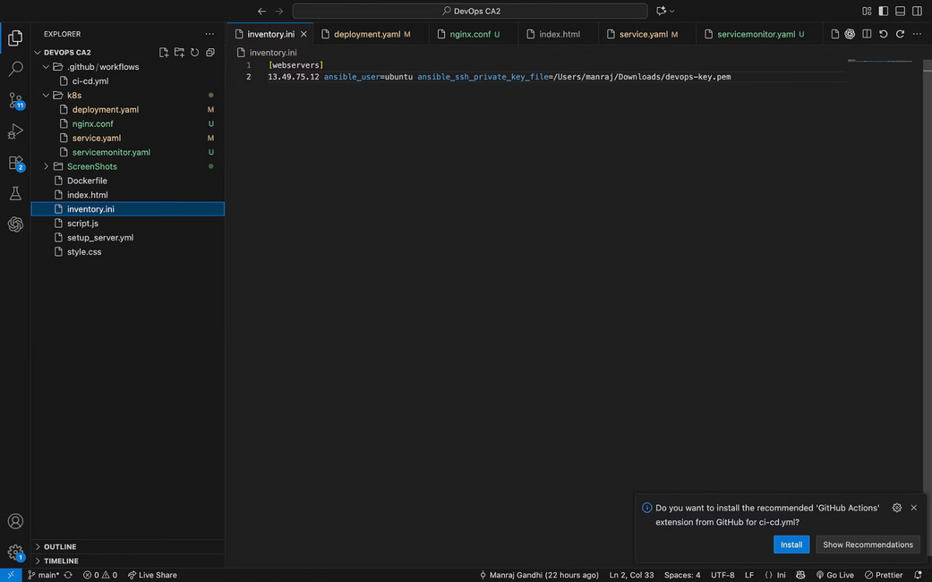
Automation: CI/CD and Infrastructure as Code
Automation ensures speed, consistency, and repeatability across the build and setup processes.
CI/CD Pipeline with GitHub Actions
Secure Authentication
1
Uses encrypted repository secrets to securely log into Docker Hub.
Image Build & Tagging
2
The workflow builds the Docker image and tags it with both :latest and a unique commit hash for version control.
Artifact Push
Infrastructure as Code (IaC) with Ansible
3
The new, versioned image is automatically pushed to Docker Hub, ready for K8s deployment.
An Ansible Playbook (setup_server.yml) was used to demonstrate automated server configuration on AWS, ensuring consistency.
Defines tasks to update base packages.
Installs the Docker engine and dependencies.
Verifies that the Docker service is running and enabled.
This adheres to the core IaC principle: repeatable, non-manual setup.
Notes:
3

Slide 4




Deployment and Observability with Kubernetes
Kubernetes manages the application's runtime state, while a dedicated monitoring stack ensures performance visibility.
Declarative Deployment
Zero-Downtime Updates
Used YAML manifests for the Deployment (3 replicas for resilience) and Service (stable network endpoint).
Achieved rolling updates with kubectl rollout restart, demonstrating seamless application patching.
Prometheus Integration
Metrics Exposure
A ServiceMonitor resource was crucial for Prometheus to automatically discover and scrape metrics from application pods.
Implemented a nginx-exporter sidecar container within the application pods to expose performance metrics.
Notes:
4

Slide 5
Challenges Encountered
1
2
Challenge 1: The ErrImagePull Mystery
Challenge 2: The "No Data" Monitoring Black Hole
Problem: Kubernetes failed to pull images from Docker Hub, despite successful CI build logs. The issue was an almost invisible failure to push the image.
Problem: Metrics were manually available via curl, but Grafana showed no data because Prometheus wasn't scraping them.
Solution: The Docker Hub access token lacked "Write" permission. Resolved by generating a new token with "Read, Write, Delete" scope, fixing the silent CI/CD push failure.
Solution: Prometheus Operator was not discovering the application. The fix required adding a missing label (e.g., app: my-website) to the Kubernetes Service manifest, completing the discovery chain.
Notes:
5

Slide 6
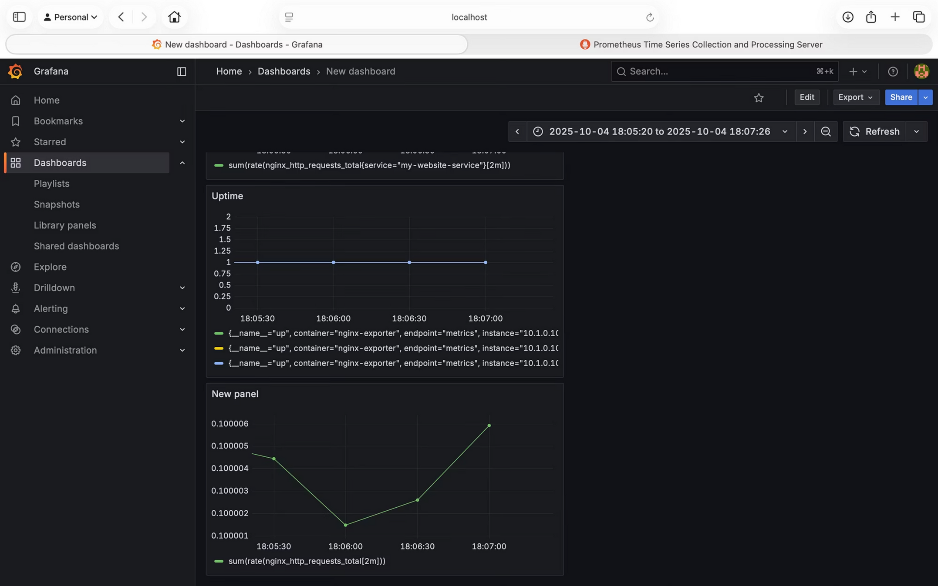
Final Outcome and Critical Lessons Learned
We successfully deployed a reliable, automatically built, and fully monitored static website. The process provided invaluable insights into the complexity of modern deployment pipelines. Dashboard for reference.
Notes:
6

